Slide 1
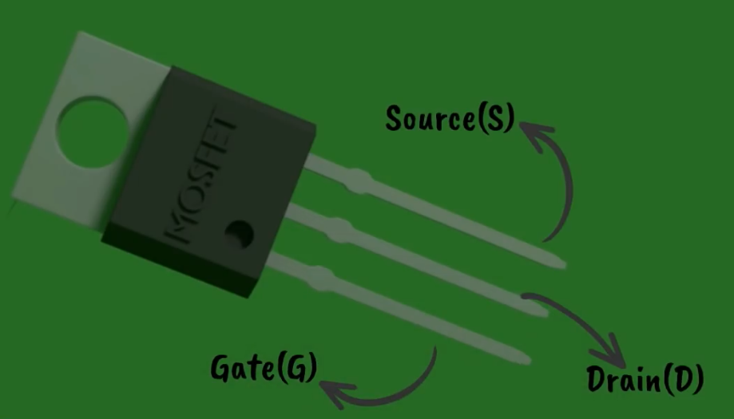
Unit 2
S-6 | SLO-1 | Characteristics of MOSFET (CS , Common drain and Common gate configurations) and uses
 | SLO-2 | MOSFET Logic

Slide 2
CONTENTS
Transistor as a Switch,
Characteristics of Digital ICs, DL, RTL, DTL, TTL, ECL, IIL,
Characteristics and uses of MOSFET (CS, Common drain and Common gate),
MOSFET Logic, PMOS,NMOS, CMOS Logic,
Propagation delay,
Tristate Logic, Tristate Logic Applications,
FPGA Basics,
Introduction to HDL and logic simulation,
HDL System primitives,
user defined primitives,
Stimulus to the design,

Slide 3
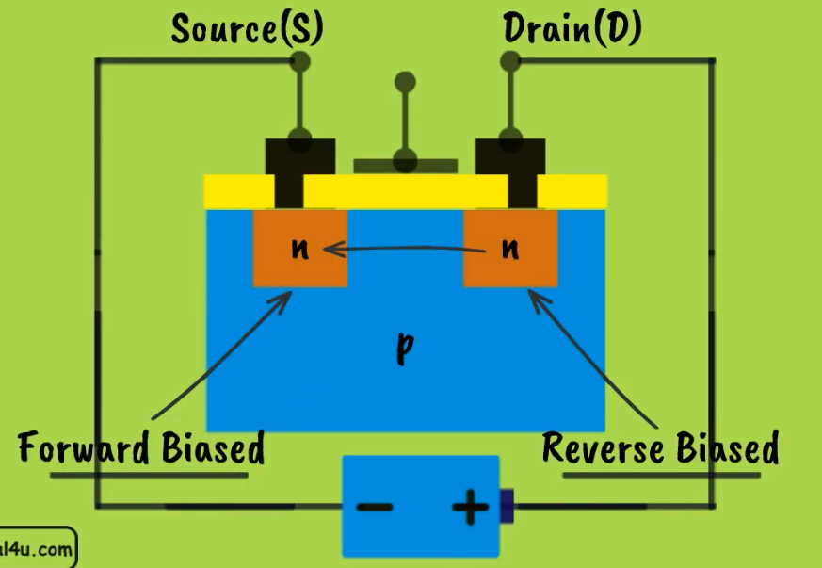

Slide 4
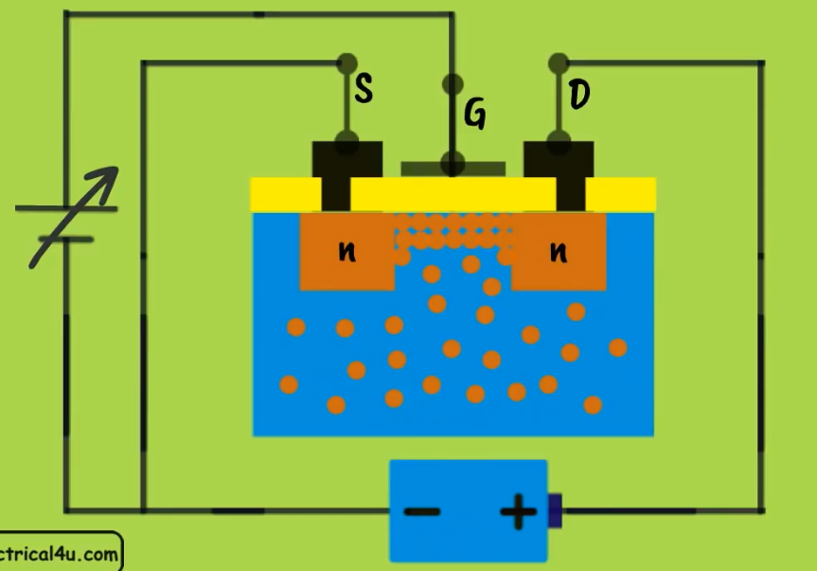


Slide 5
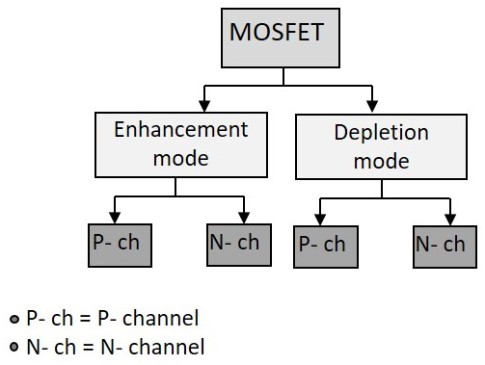
MOSFETs
MOSFETs are tri-terminal, unipolar, voltage-controlled, high input impedance devices which form an integral part of vast variety of electronic circuits.
There are 2 types of MOSFET’s (metal–oxide–semiconductor field-effect transistor)

Slide 6
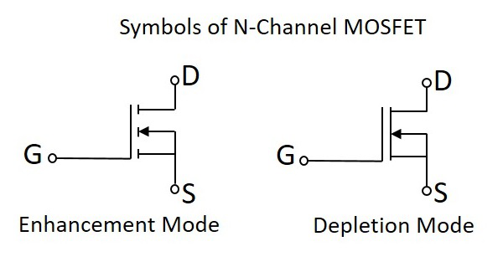
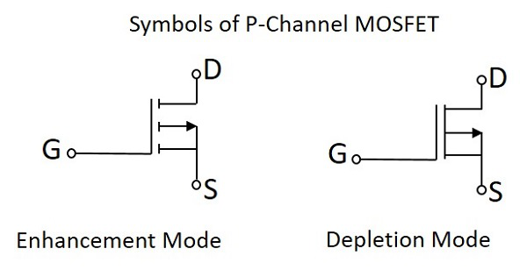
I_{D}= I_{S}
I_{S}

Slide 7
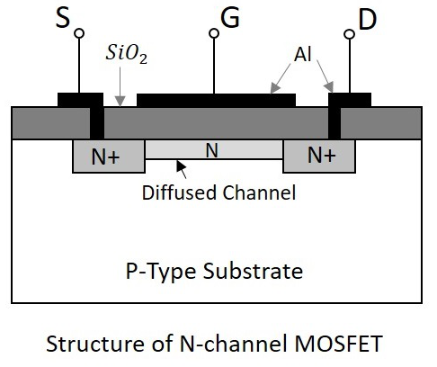
Construction of N- Channel MOSFET

Slide 8
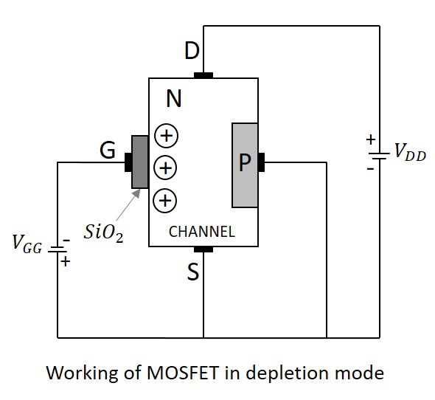
Working of N - Channel depletion mode MOSFET
With some amount of negative potential at V_{GG} a certain amount of drain current I_{D} flows through source to drain.
When this negative potential is further increased, the electrons get depleted and the current I_{D} decreases.
Hence the more negative the applied V_{GG}, the lesser the value of drain current I_{D} will be.

Slide 9
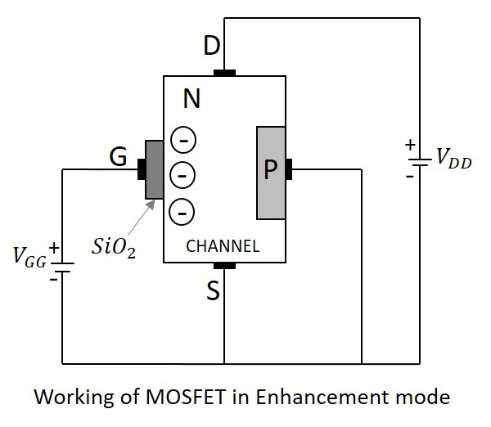
Working of N-Channel MOSFET Enhancement Mode
With some amount of positive potential at V_{GG} a certain amount of drain current I_{D} flows through source to drain.
When this positive potential is further increased, the current I_{D} increases due to the flow of electrons from source and these are pushed further due to the voltage applied at V_{GG}.
Hence the more positive the applied V_{GG}, the more the value of drain current I_{D} will be.
The current flow gets enhanced due to the increase in electron flow better than in depletion mode.

Slide 10
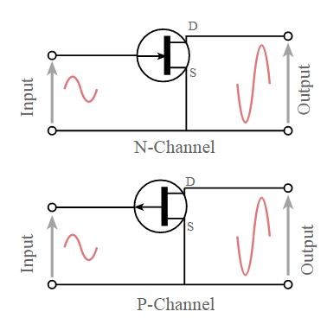
Configuration - CS
Common source: This MOSFET configuration is probably the most widely used. The common source circuit provides a medium input and output impedance levels. Both current and voltage gain can be described as medium, but the output is the inverse of the input, i.e. 180° phase change. This provides a good overall performance and as such it is often thought of as the most widely used configuration.

Slide 11
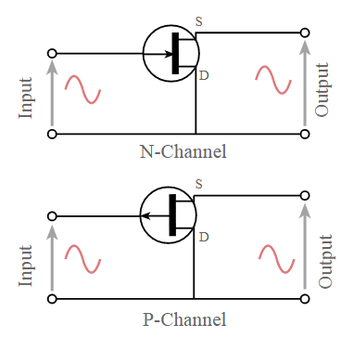
Configuration - CD
Common source: This MOSFET configuration is also known as the source follower. The reason for this is that the source voltage follows that of the gate. Offering a high input impedance and a low output impedance it is widely used as a buffer. The voltage gain is unity, although current gain is high. The input and output signals are in phase.

Slide 12
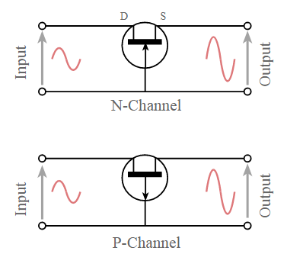
Configuration - CG
Common source: This transistor configuration provides a low input impedance while offering a high output impedance. Although the voltage is high, the current gain is low and the overall power gain is also low when compared to the other MOSFET circuit configurations available. The other salient feature of this configuration is that the input and output are in phase.

Slide 13
MOSFET characteristics
Basically low voltage device. High voltage device are available up to 600V but with limited current. Can be paralleled quite easily for higher current capability.
Internal (dynamic) resistance between drain and source during on state, R_{DS}(ON), , limits the power handling capability of MOSFET. High losses especially for high voltage device due to R_{DS}(ON) .
Dominant in high frequency application (>100kHz). Biggest application is in switched-mode power supplies.

Slide 14
The transistor consists of three regions, labeled the ``source'', the ``gate'' and the ``drain''.
The area labeled as the gate region is actually a ``sandwich'' consisting of the underlying substrate material, which is a single crystal of semiconductor material (usually silicon); a thin insulating layer (usually silicon dioxide); and an upper metal layer.
Electrical charge, or current, can flow from the source to the drain depending on the charge applied to the gate region.
The semiconductor material in the source and drain region are ``doped'' with a different type of material than in the region under the gate, so an NPN or PNP type structure exists between the source and drain region of a MOSFET.

Slide 15
3 Operating Regions of MOSFET
Cut-Off Region Cut-off region is a region in which the MOSFET will be OFF as there will be no current flow through it. In this region, MOSFET behaves like an open switch and is thus used when they are required to function as electronic switches.
Ohmic or Linear Region Ohmic or linear region is a region where in the current I_{DS} increases with an increase in the value of V_{DS}. When MOSFETs are made to operate in this region, they can be used as amplifiers.

Slide 16
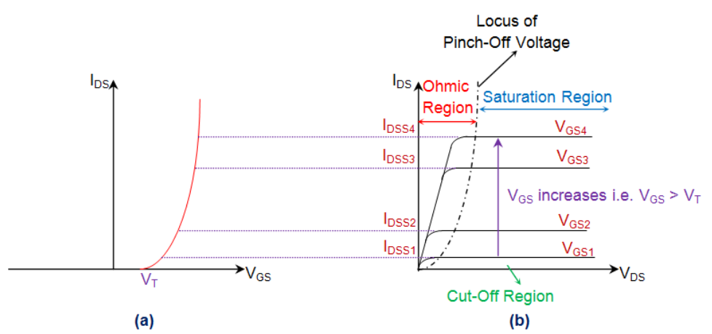

Slide 17
3 Operating Regions of MOSFET
Saturation Region
In saturation region, the MOSFETs have their I_{DS} constant inspite of an increase in V_{DS} and occurs once V_{DS} exceeds the value of pinch-off voltage V_{P}.
Under this condition, the device will act like a closed switch through which a saturated value of I_{DS} flows.
As a result, this operating region is chosen whenever MOSFETs are required to perform switching operations.

Slide 18
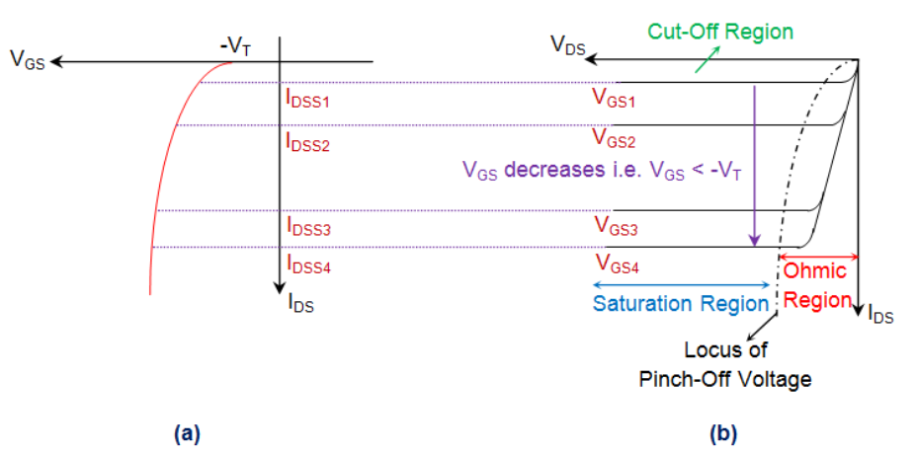

Slide 19
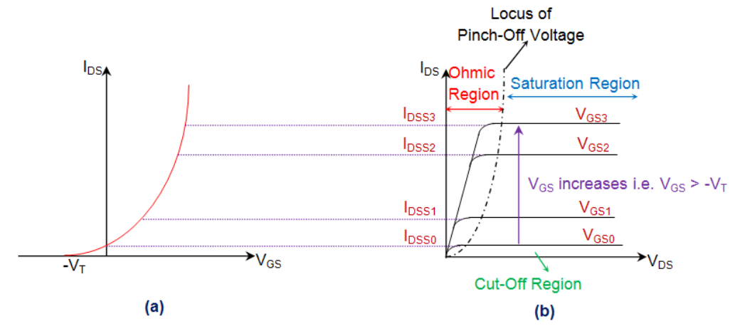

Slide 20
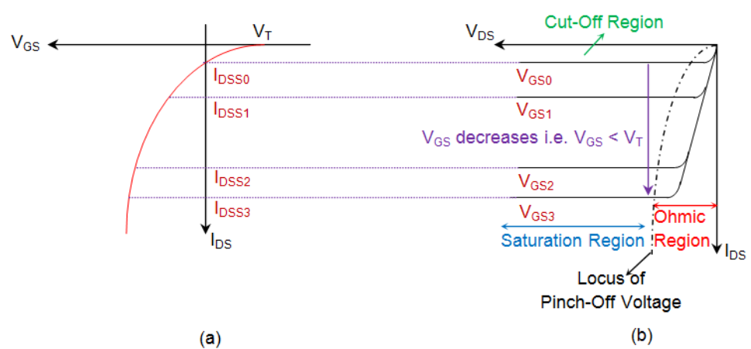

Slide 21
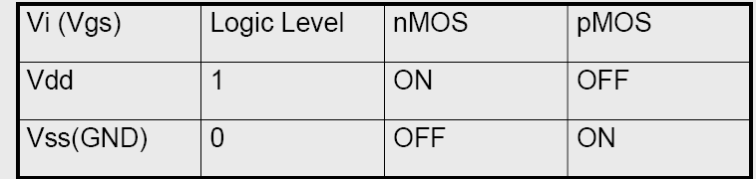
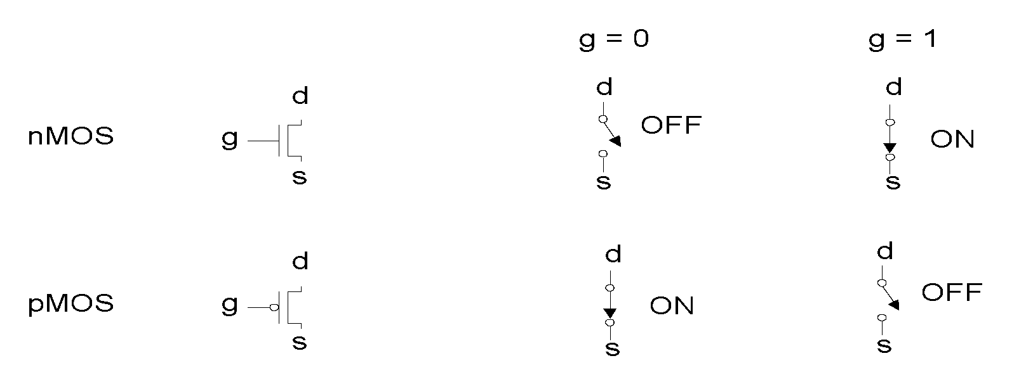
Switch models of MOSFETs

Slide 22
MOSFET - Uses
Most important device in digital design
Very good as a switch
Relatively few parasitics
Rather low power consumption
High integration density
Simple manufacturing
Economical for large complex circuits

